Slide 1
Imaging Today

Slide 2
Objective
To Highlight the increasing impact of cancer on health care and general population
To create awareness regarding the harmful effects of radiation including diagnostic radiation and the impact of low dose CT imaging
To introduce best imaging practices in India and bring the best radiologists in the world to India to share their experience

Slide 3
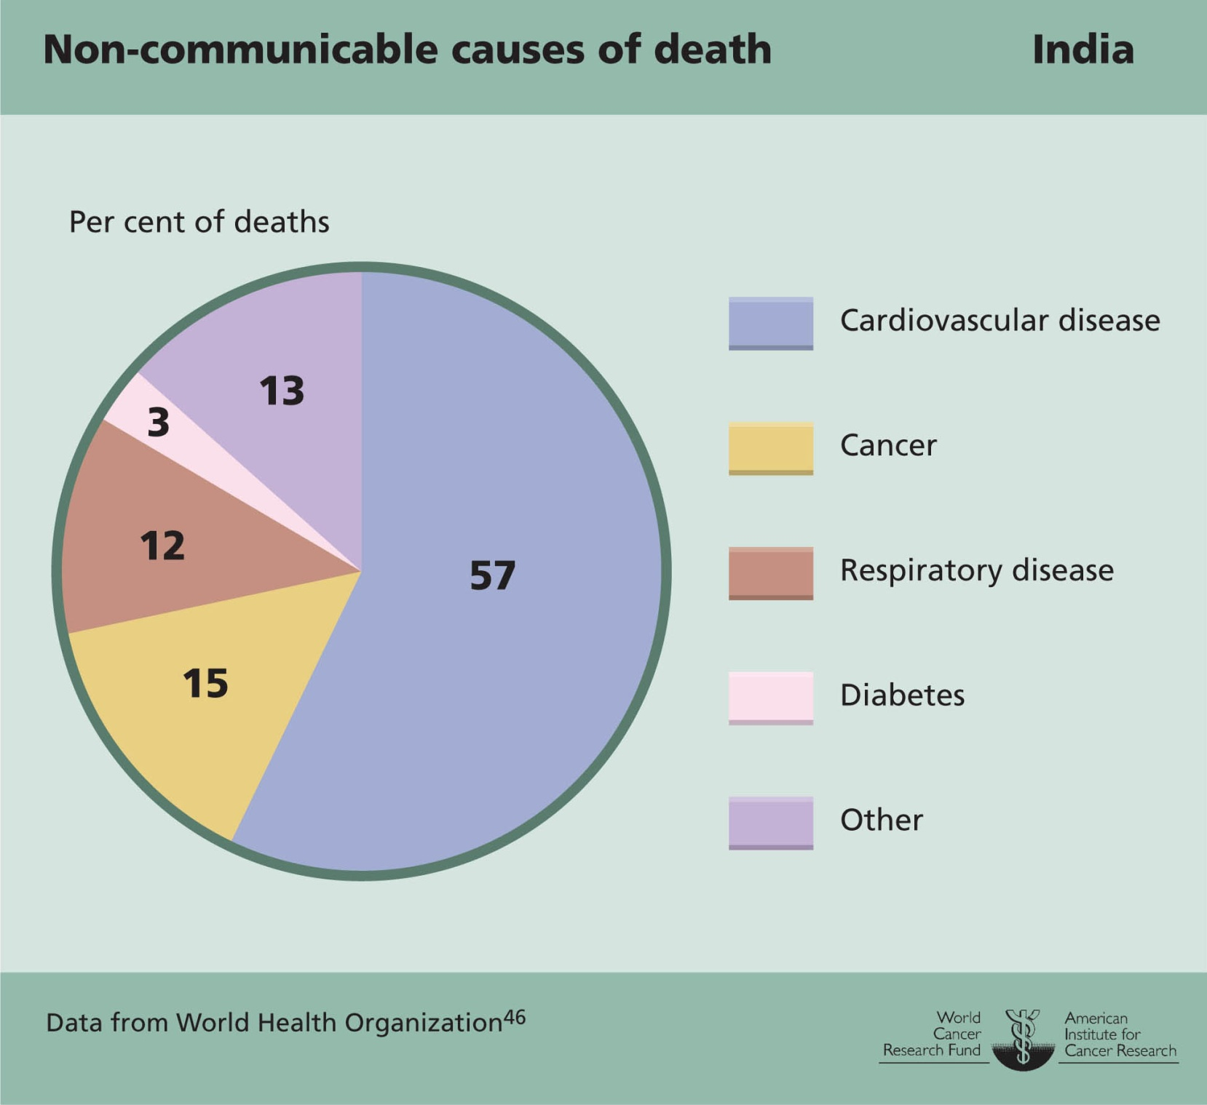
Background
Cancer is the second most common cause of death amongst non communicable diseases in Indians with approximately15 percent of all deaths from a non communicable cause occuring due to cancer

Slide 4
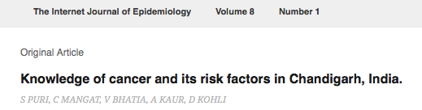
Knowledge about Cancer
In a study carried out in Chandigarh in 2009, about 3/4th of respondents could correctly name the common cancers but the knowledge about preventive modes of cancer was lacking as only 2.5%(23) of Urban population and none among slum population were Knowing about prevention
None of the respondents could enumerate all the warning symptoms of cancer. 3/4th (307, 22.7%) of respondents knew about the tobacco as a risk factor for cancer followed by alcohol
Thus, there is a great need for increasing the awareness in masses by collaborative action of public health specialists, health professionals and via IEC activities.

Slide 5
Radiation and Cancer
Up to 10% of invasive cancers are related to radiation exposure
Cancer is a stochastic effect of radiation, meaning that the probability of occurrence increases with effective radiation dose, but the severity of the cancer is independent of dose.
Thus if a person receives less radiation, the chance of radiation induced cancer decreases

Slide 6
X Rays, CT and Radiation
A 'computerized tomography' (CT) (or 'computerized axial tomography' (CAT) scan) uses a computer that takes data from several X-ray images of structures inside a human's or animal's body and converts them into pictures on a monitor.

Slide 7
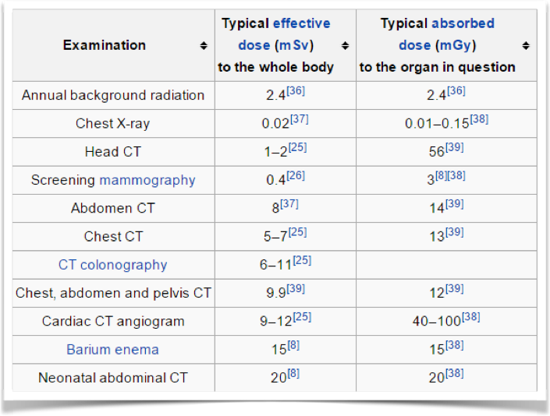
Dose of CT is High as compared to X Ray

Slide 8
Radiation and CT
It is commonly thought that the extra risk of any one person developing a fatal cancer from a typical CT procedure is about 1 in 2,000. In contrast, the lifetime risk of dying from cancer in the U.S. population is about 1 in 5
Radiation exposure from CT scans affects adults and children differently. Children are considerably more sensitive to radiation than adults because of their growing bodies and the rapid pace at which the cells in their bodies divide. In addition, children have a longer life expectancy than adults, providing a larger window of opportunity for radiation-related cancers to develop
U.S. Food and Drug Administration (August 2009). What are the Radiation Risks from CT? Retrieved July 19, 2013.

Slide 9
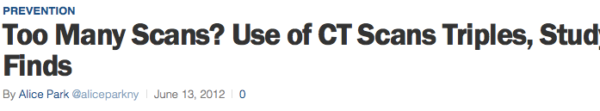
Increasing Use of CT
A 2012 article in TIME magazine reported a tripling of number of CT scans in the USA.
149 out of every thousand patients had a CT scan- almost 15 percent of ALL patients, which is a significant number

Slide 10
Ways to reduce dose
Avoid Radiation
Receive Less radiation
Since CT scans and thus radiation is not received by choice, a scanner which receives less dose would be preferable over one which gives a higher dose for the same examination
Philips has been among the first to use iterative reconstruction technique in clinical practice and Sir Ganga Ram Hospital scans ALL patients with this technique leading to significantly reduced doses for ALL PATIENTS

Slide 11
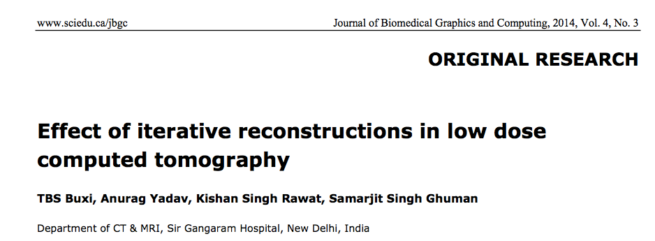
Dose Reduction inCT

Slide 12
Dose Reduction in CT
Substantial dose reduction is achieved with iterative techniques. In 986 patients scans evaluated, average dose reduction of 33.2% in Thorax, 32.455% in Abdomen/Pelvis and 49.706% in head examinations were estimated.
Thus the Philips Ingenuity CT installed in Sir Ganga Ram Hospital leads to substantial radiation dose reduction

Slide 13
Imaging Today Update
This is a unique event being carried out by the Department of CT and MRI of Sir Ganga Ram Hospital with top national and international faculty from various fields discussing the latest in the field of medical imaging. The international faculty includes Dr Barkovich and Dr Antonio Westphalen from University of California in San Francisco, Dr Vikram Dogra from University of Rochester and Dr Johan Haaga from Case Reserve Western University

Slide 14
National faculty is from AIIMS, Fortis and Max Hospitals, Reliance, Breach Candy, and Jaslok Hospitals in Mumbai, Narayana Hriduyala hospitals, and Vijaya Hospitals among others
These Doctors are the best in the country and will help to impart and exchange knowledge and help in training the resident doctors who are the future radiologists in India, thus leading to improved care for patients in particular and society in general

Slide 15
Thank You

